Slide 1
SNAKES AND LADDERS

Slide 2
Team Members
Phyu Phyu Ei Chaw (3CS-5)(Presenter)
Yadanar Nadi Tun (3CS-14)
Wanna Min Paing (3CS-28)(Leader)
Kyaw Zin Aung (2CS-5)
Aung Kaung Myat (2CS-19)

Slide 3
Objective
To develop children counting skills and addition skill
To develop social language skills in that bad things can happen suddenly and without warning
To understand maths language and sequential numbers

Slide 4
Content
What is Snakes and Ladders?
How to play?
Features of Game
Targeted Customer
Guide Lines
Advantages
Disadvantages
Why should we play this game?
Future Expansion

Slide 5
What is Snakes and Ladders?
Snakes and Ladders is an ancient Indian board game regarded today as a worldwide classic. It is played between two more players on a game board having numbered, gridded squares. A number of 'ladders' and 'snakes‘ are pictured on the board, each connecting specific board squares. The object of the game is to navigate one's game piece, according to die rolls, from the start(bottom square)to the finish(top square),helped or hindered by ladders and snakes, respectively.

Slide 6
How to play?
Each player puts their runner on the bottom of board.
Take it in turns to roll the dice. Move your runner forward the number of spaces shown on the dice.
If your runner lands at the bottom of a ladder, you can move up to the top of the ladder.
If your runner lands on the head of a snake, you must slide down to the bottom of the snake.
The first player to get to the space that says'No.100(Win)' is the winner.

Slide 7
Features of Games
Play to double users
Play with two to four users
Game rules

Slide 8
Targeted Customers
Double user
Teenager
Children

Slide 9
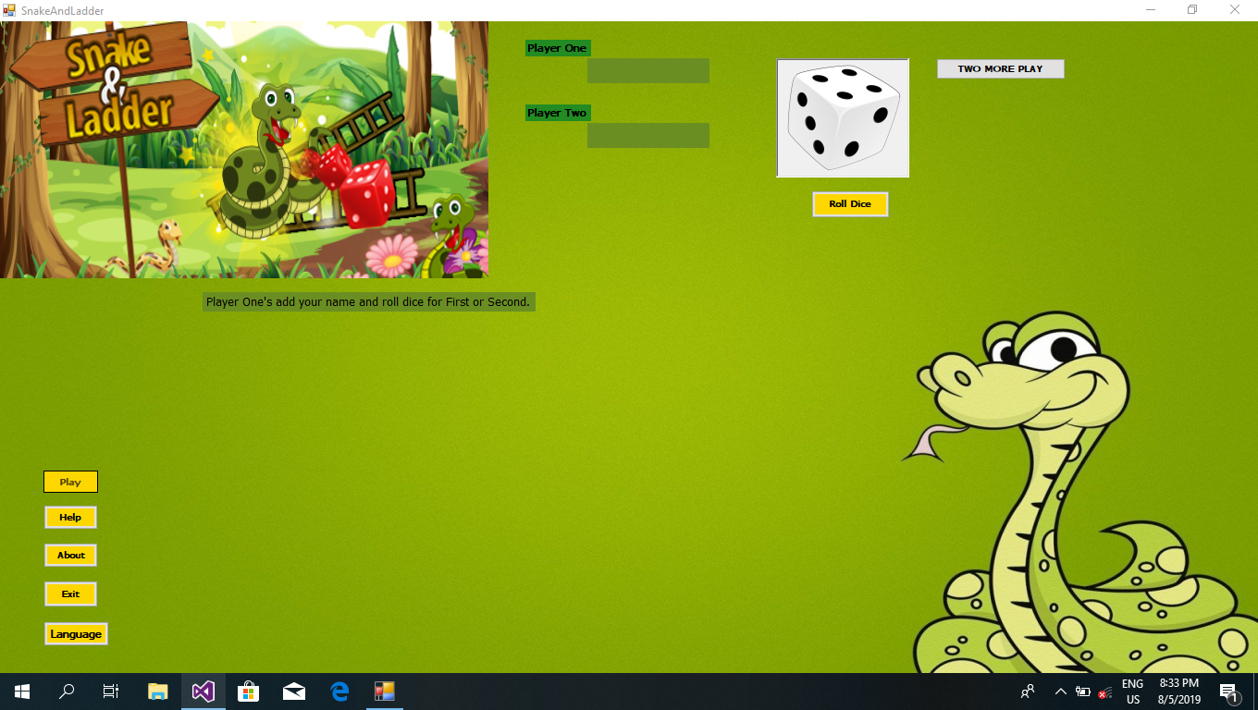
Guide Lines

Slide 10
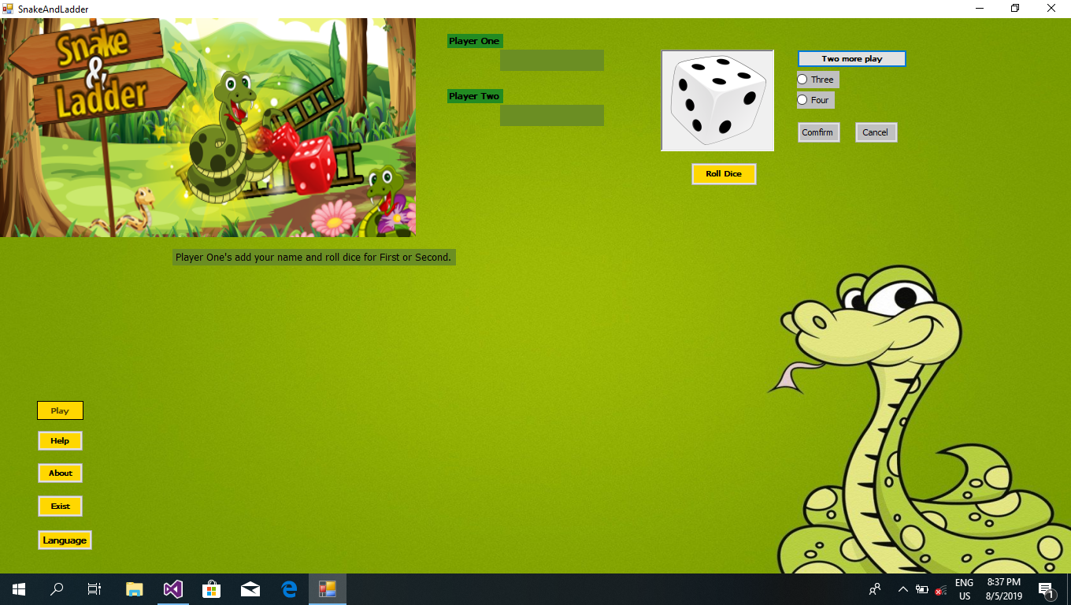

Slide 11
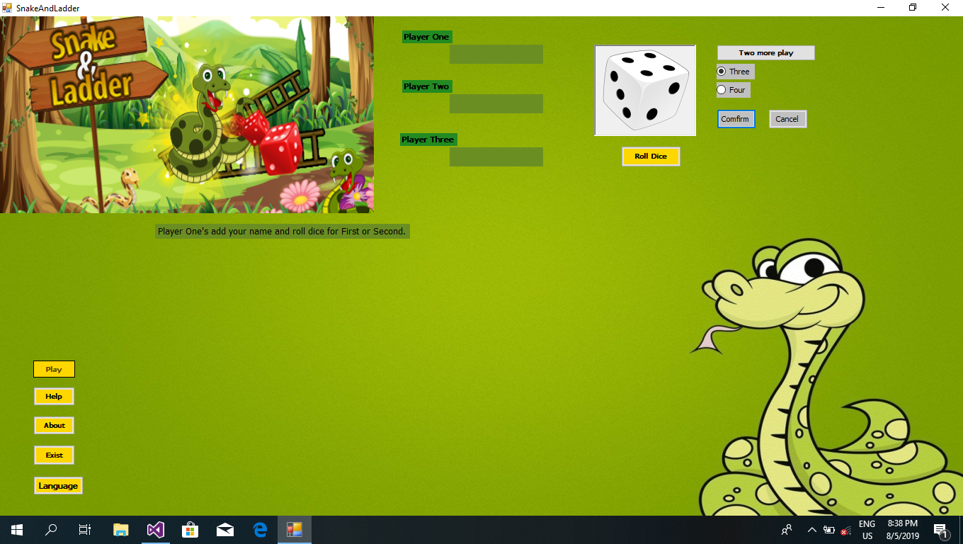

Slide 12
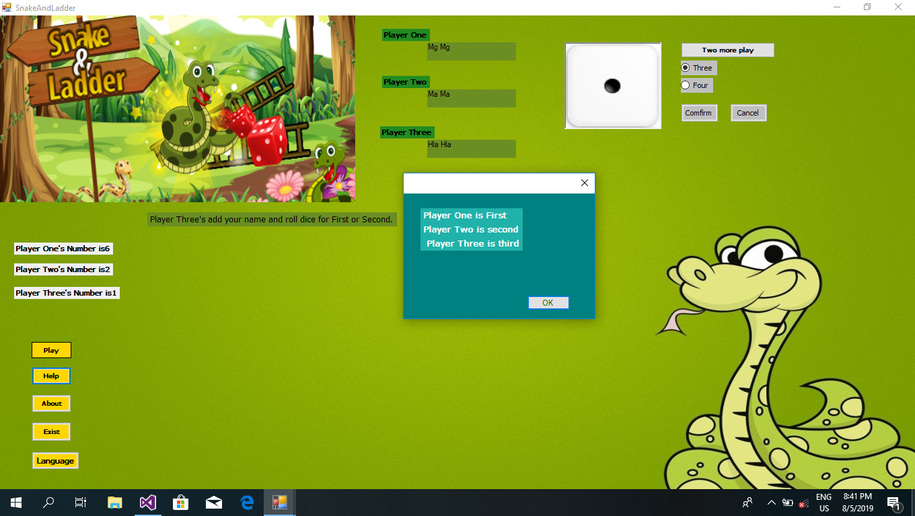

Slide 13
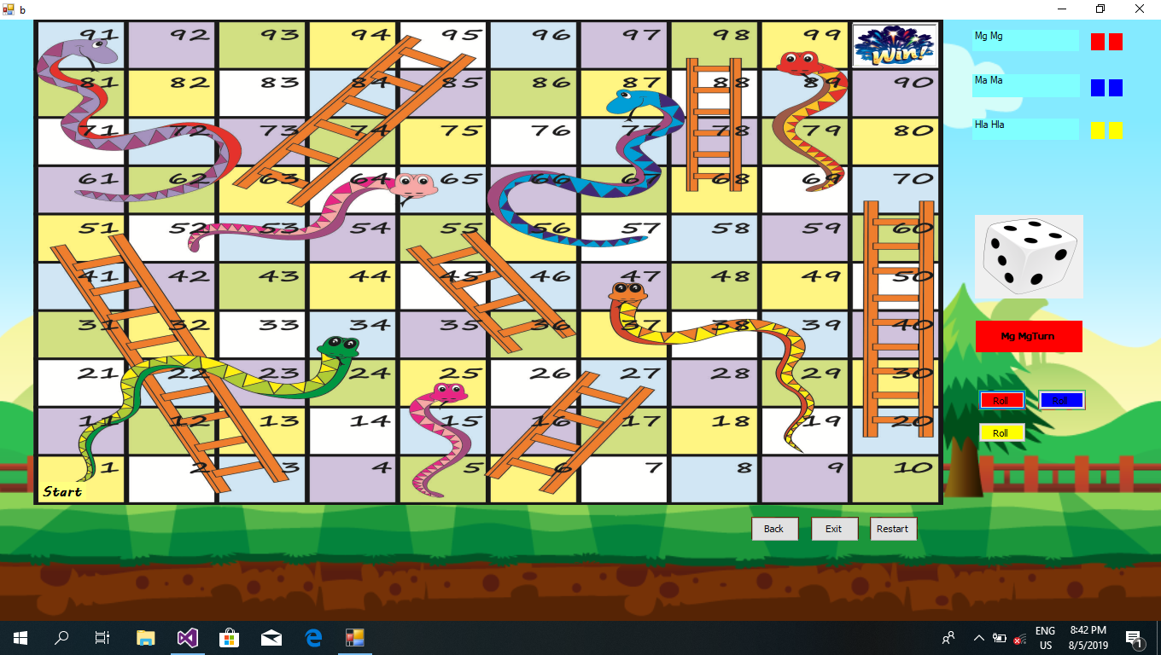

Slide 14
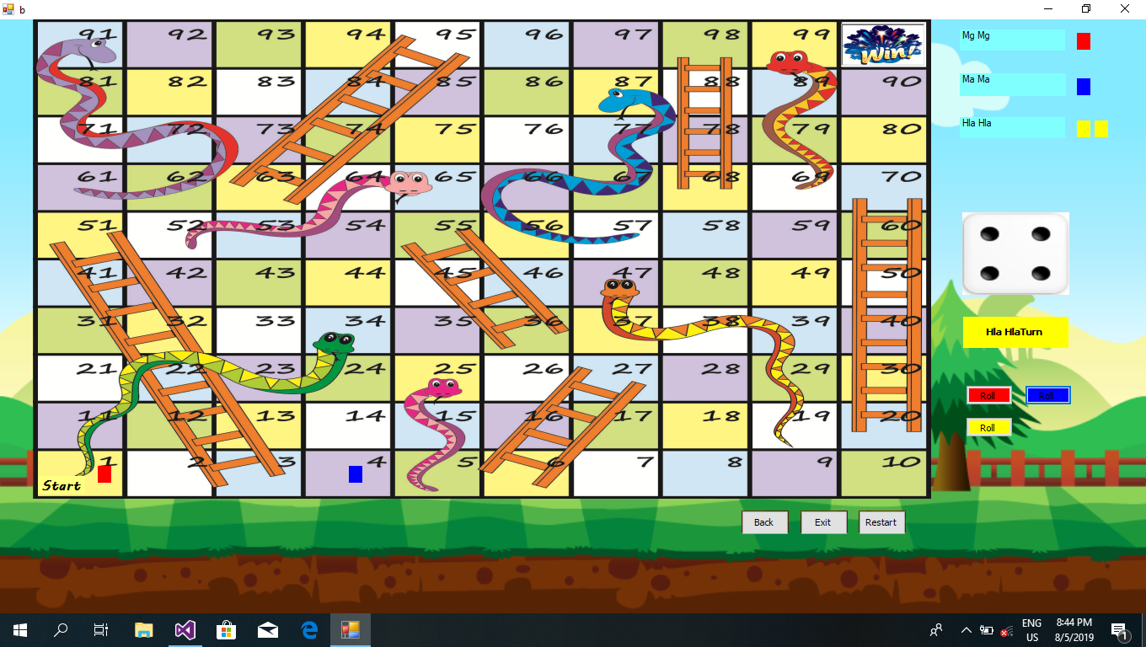

Slide 15


Slide 16
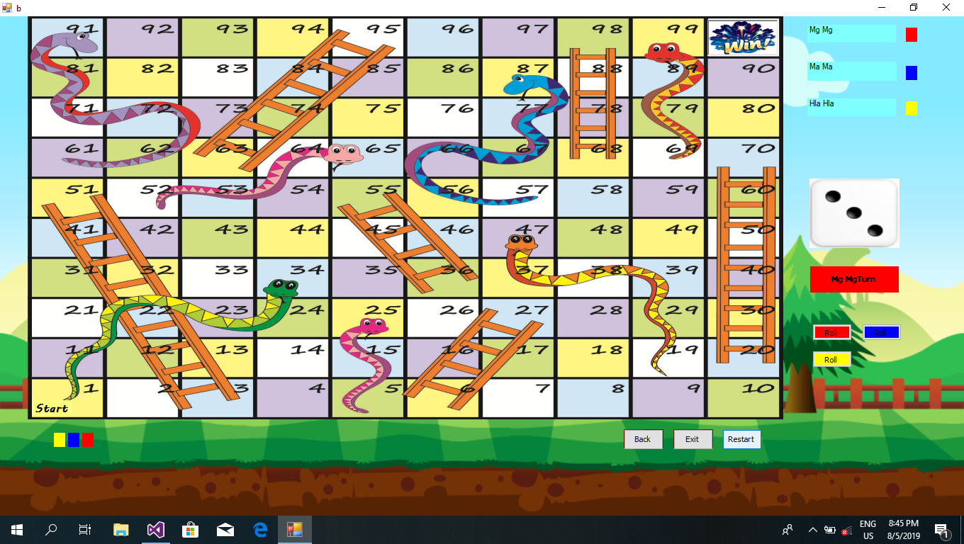

Slide 17
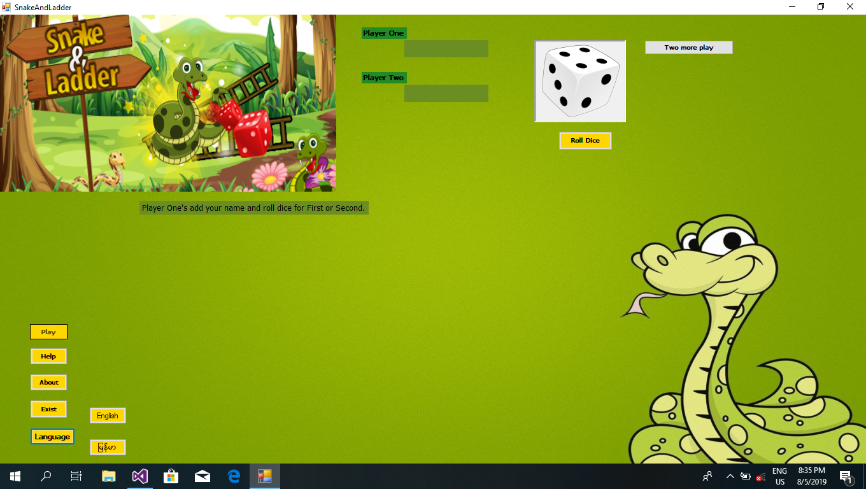

Slide 18
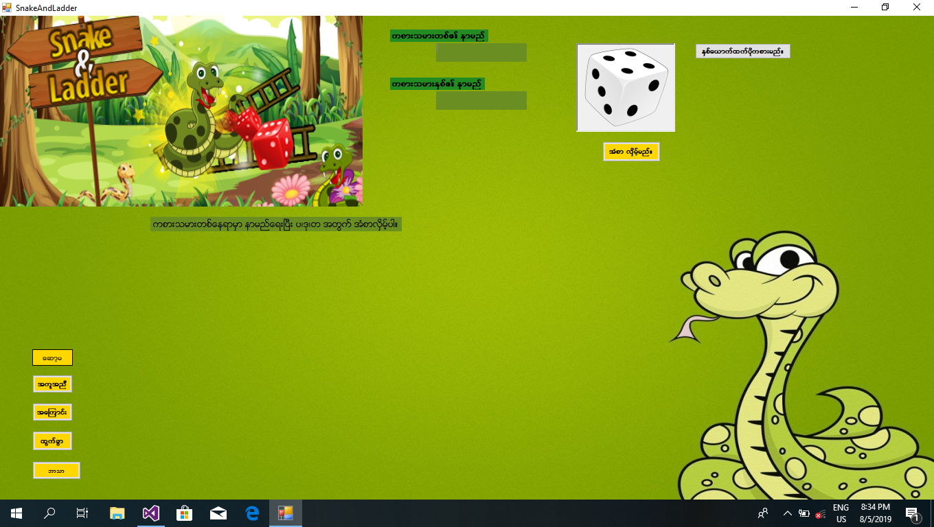

Slide 19
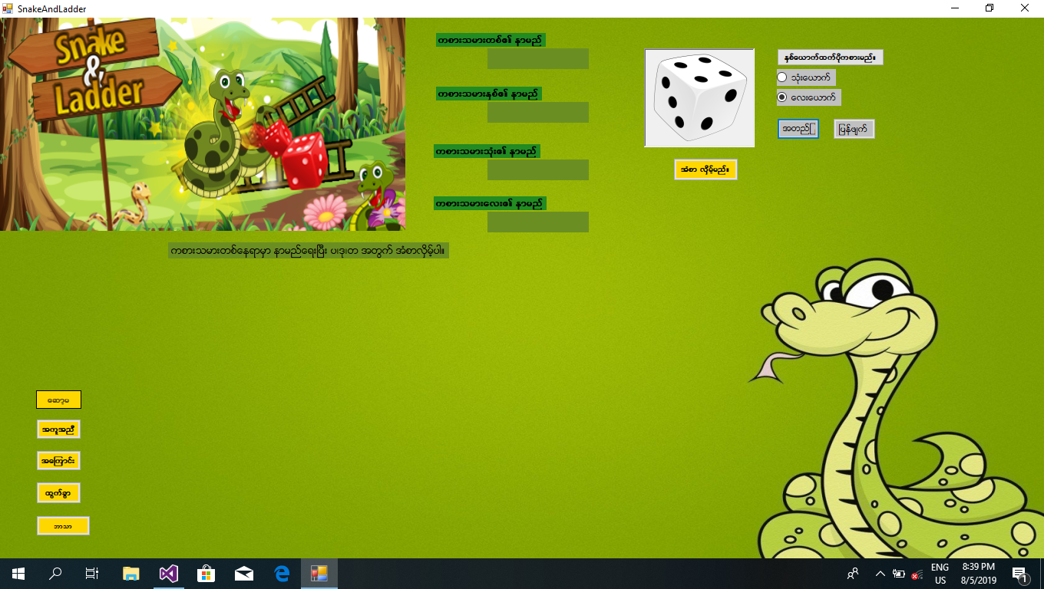

Slide 20
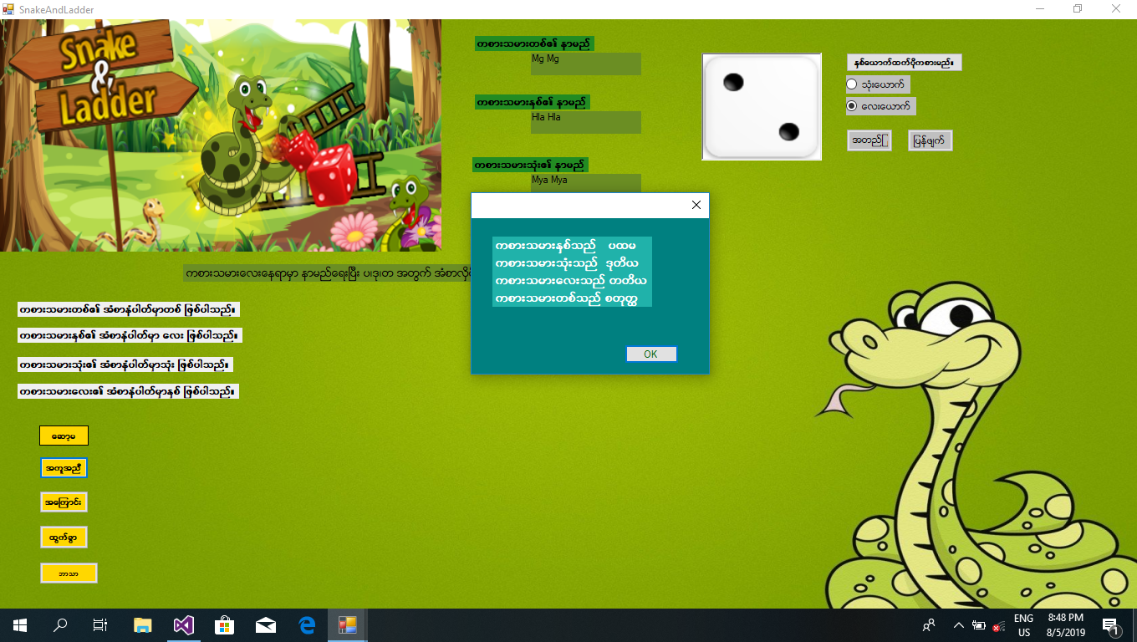

Slide 21


Slide 22


Slide 23
Advantages
Education
Social
Cheaper than video games
Helps the mind by reducing risks for mental diseases
Helps kids interacts with each other

Slide 24
Disadvantages
Only a certain number of people can play.
Games can take a very long time to play.
Some games can cause stress addiction.
Some people might think this games are for little kids.

Slide 25
Why should we play this game?
To remember classic puzzle games and
we can play these game on PC.
We can learn others like mathematics,
weather, english grammar by playing games.

Slide 26
Future Expansion
We can add other functions like mathematics and weather informations etc...
We can add vocabulary about daily routine, household chores and free time activities on each space on the board.
We can add various informations for children

Slide 27
Thank You
Any Question?

